Slide 1


Claude Builder Club @ University of Cambridge

Slide 2
Table of contents
What is Claude?
What is Claude Builder Club?
What is MCP?
Hands-on Session

Slide 3
We founded Anthropic because we believe the impact of AI might be comparable to that of the industrial and scientific revolutions, but we aren’t confident it will go well. And we also believe this level of impact could start to arrive soon – perhaps in the coming decade."
“
Anthropic
Notes:
Anthropic is an AI research company that develops AI systems like the large language model Claude and there mission is to build AI that is reliable, interpretable, and beneficial to humanity.

Slide 4
People want AI to help them extend their thinking, not to think less
Perceptions of AI today
What people want from an AI relationship
“Right now, it’s like a vending machine: I input a prompt, it spits something out.”
“Sometimes I want it to help me think. Not just solve. Like a creative partner you bounce ideas off for hours.”
“A cheerleader is nice, but sometimes I want a sparring partner - that’s how ideas grow and that’s not what ChatGPT does today.”
“I don’t want an assistant. I want something that can help me get better at thinking, at writing, at strategy.”
SOURCE: Anthropic Positioning Research, July, 2025
Notes:
They want to build an AI that can help people think not just an assistant.

Slide 5
Where others promise easy answers, Claude provides the cognitive power to take on harder problems.
Claude is the AI for problem solvers.
The opportunity
Notes:
That’s why they built Claude which can provides the cognitive power to take on harder problems.

Slide 6
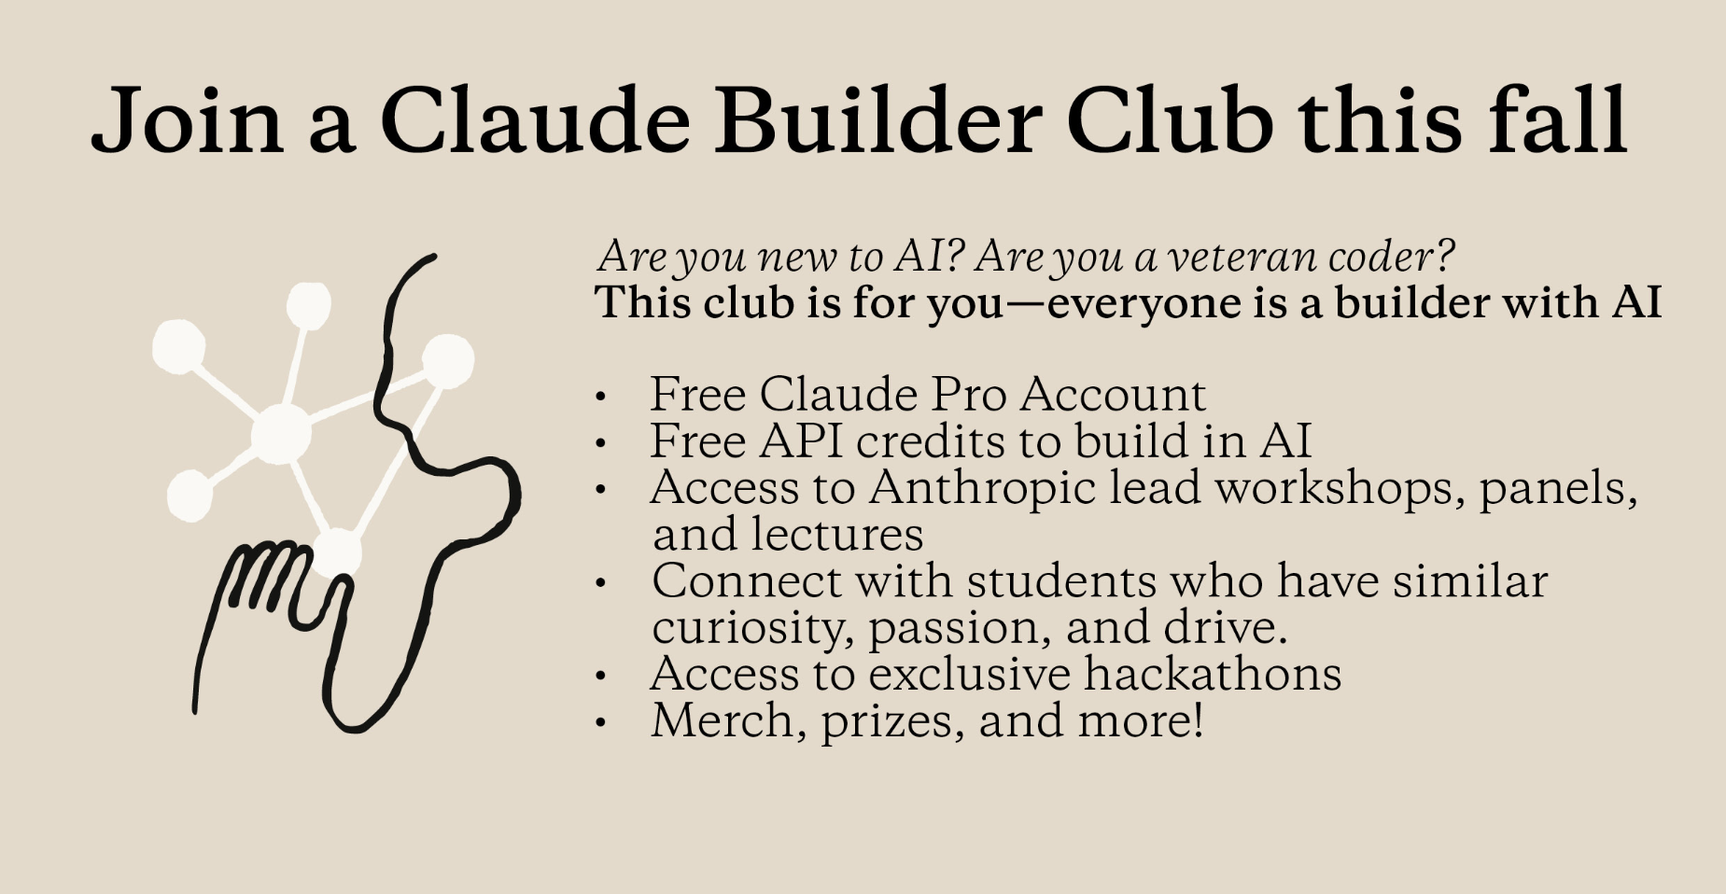
Notes:
As Claude Builder Club at the University of Cambridge, we’re going to give opportunities for students to learn and build something with Claude. (Explain benefits, events)

Slide 7
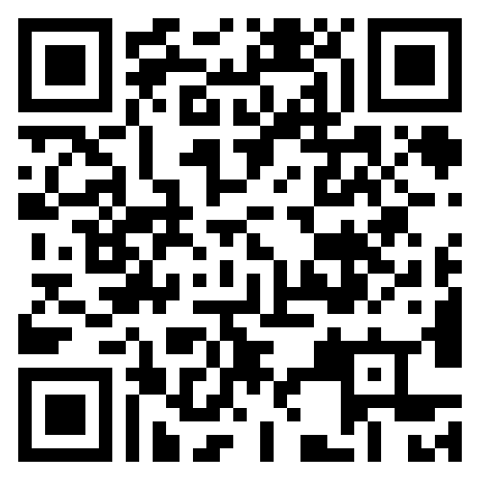
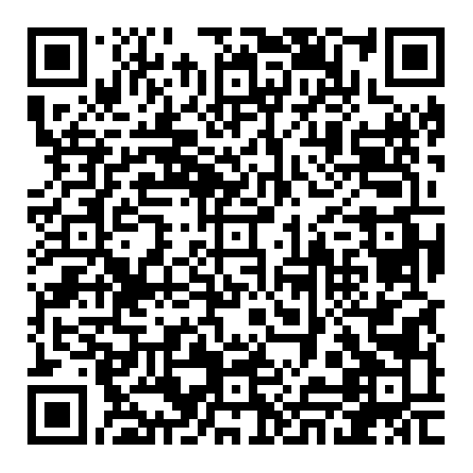
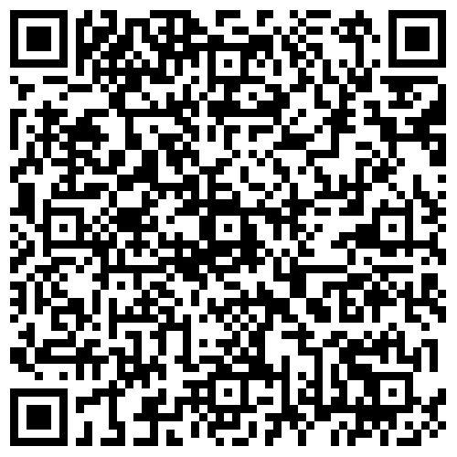
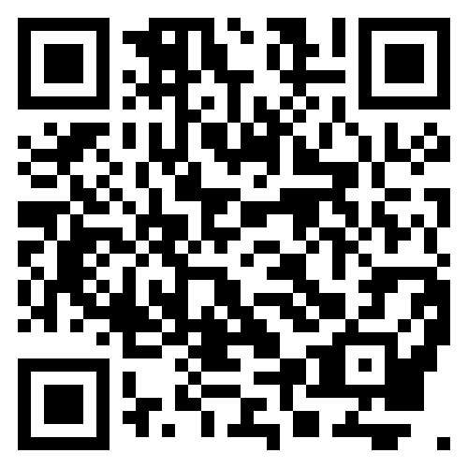
Join the Claude Builder Club
CBC is run by the Cambridge University AI Builder Club (CUABC).
To receive benefits and event notifications, you'll need to sign up for both the society and CBC using the QR codes below.
CBC Sign-up
Sign up today to become an official member of the Claude Builder Club
Get 6 months of Claude Pro free
Join member-exclusive events
CBC Check-in
Check in at CBC events
Receive $50 in Claude API credits (one-time offer)*
CUABC Sign-up
Sign up today to join CUABC and access community events, workshops, and learning opportunities
Sign up and join our Discord channel for event updates and announcements
CUABC Instagram
Follow us on Instagram to stay informed about CBC events and news

Slide 8
What is MCP?
Claude Builder Club – Model Context Protocol Workshop

Slide 9
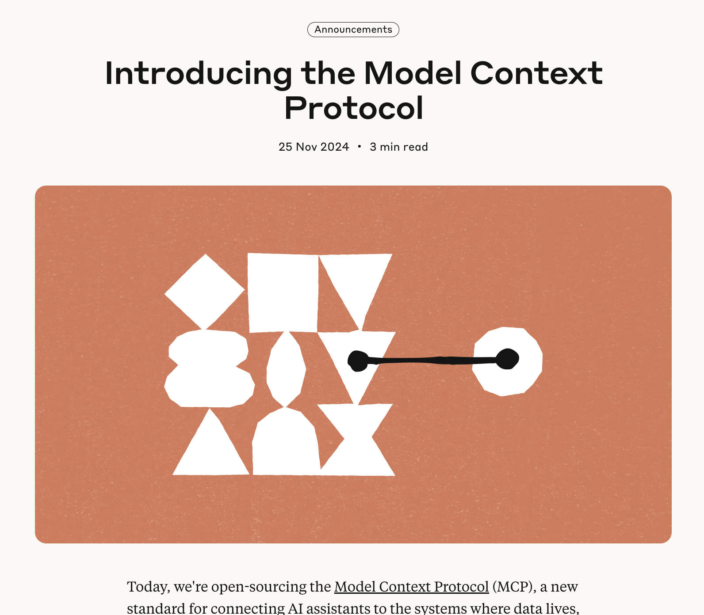
Model Context Protocol
The Problem MCP Solves:
AI assistants were isolated from data - trapped behind information silos and legacy systems, with every new data source requiring its own custom implementation, making truly connected systems difficult to scale.
Simple Analogy:
MCP is like a USB-C port for AI applications - just as USB-C provides a standardized way to connect devices to various peripherals, MCP provides a standardized way to connect AI models to different data sources and tools.

Slide 10
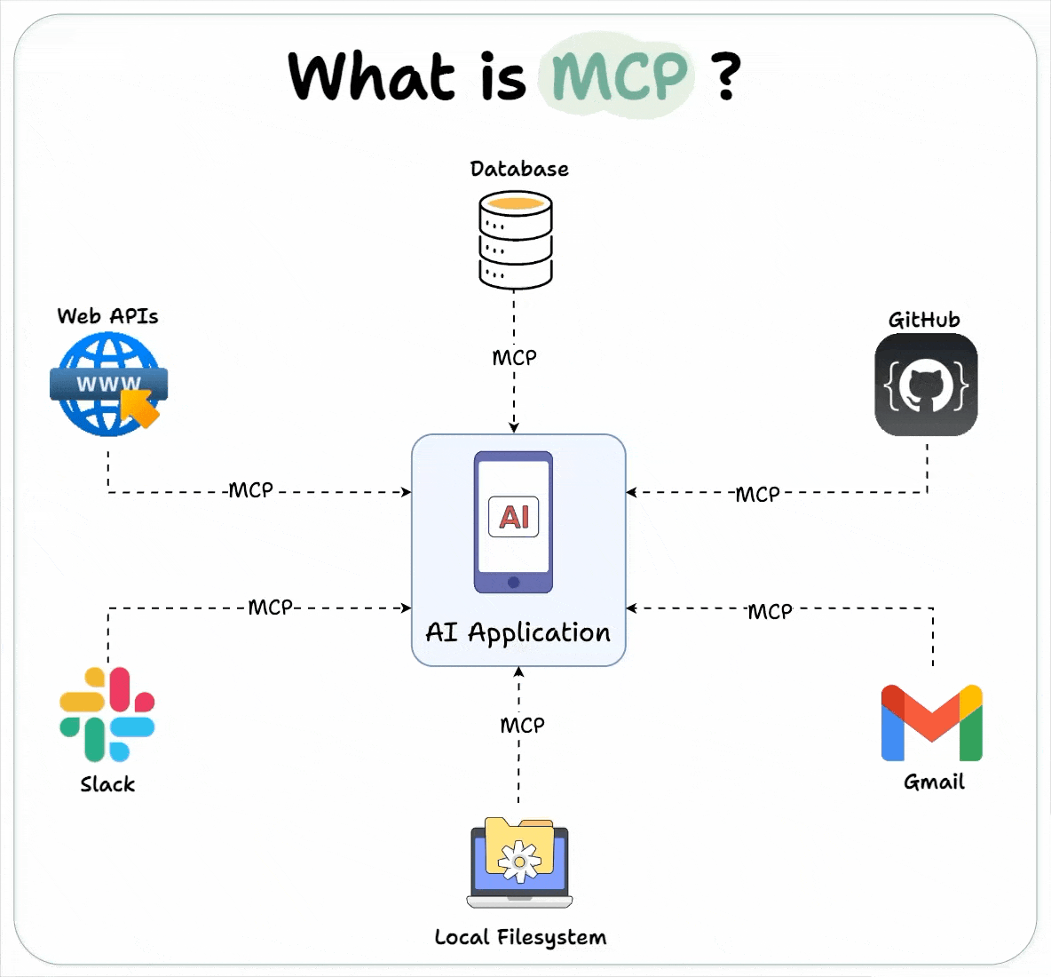
What is MCP?
The Model Context Protocol (MCP) is an open standard that allows large language models (LLMs) to communicate with external data, tools, and applications. It acts as a standardised interface, enabling AI agents to access resources like databases, search engines, and local files, so they can perform tasks beyond their initial training data.

Slide 11
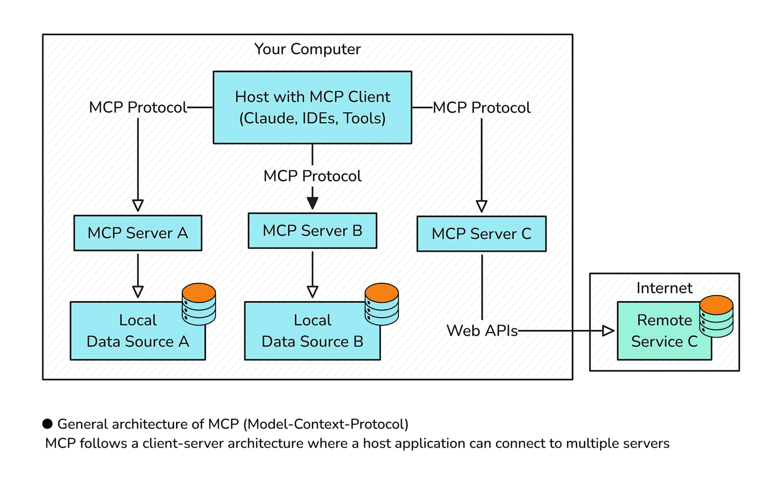
MCP Architecture
MCP Client:
MCP Clients are AI applications that connect to these servers to enhance their capabilities.
Discover what resources and tools are available
Make requests to servers on behalf of the AI
Handle the communication protocol
MCP Servers:
MCP Servers expose resources and capabilities to AI applications.
Resources: Data sources like files, databases, or API endpoints
Tools: Functions the AI can call to take actions
Prompts: Pre-written prompt templates

Slide 12
Hands-on Session
Claude Builder Club – Model Context Protocol Workshop

Slide 13
Thank you
Thank you

